Slide 1
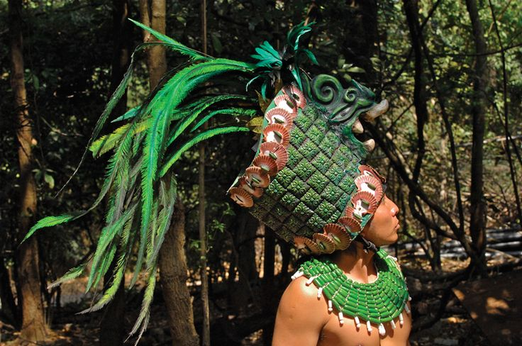
Mayan Dress and Armor
Daniela Villanueva・Risa Hanazawa・D'Andre Thompson

Slide 2
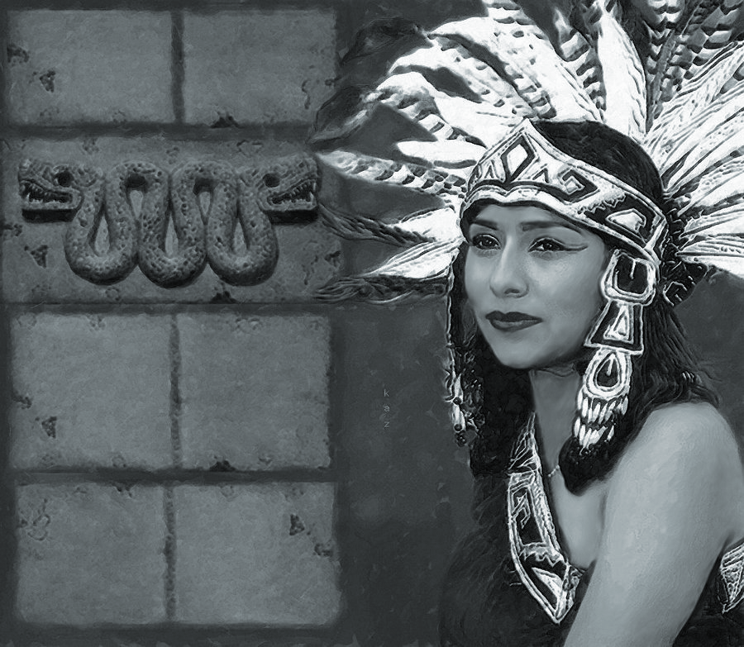
Outline
Materials Used
Process
Clothing
Men
Women
Sporting wear
Ceremonial wear
Accessories
Jewelry
Notes:
Occasions -every diary clothes -public events -dance costume -ball game uniform, sporting attire -protective armour, warrior uniform How different were the clothing of nobles and that of ordinary people?
Body decoration - body painting
Accessories - Jewery - jade and [feather headdress]

Slide 3
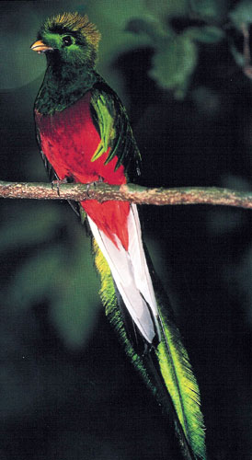
Materials used
Maya used many natural resources
The more difficult to retrieve, the higher probability it would be more sacred (or exclusive to nobility) than other resources
Back Strap Loom
Spindle
Notes:
http://www.mexicolore.co.uk/maya/teachers/what-did-the-ancient-maya-wear
https://en.wikipedia.org/wiki/Maya_textiles
https://www.flmnh.ufl.edu/maya/maya4.htm

Slide 4
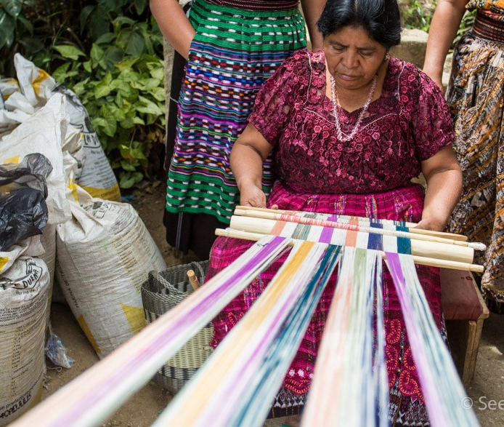
Process
Fabrics & Textiles
Wool
Cotton
Agave plant
Dyes & Colourants
Flowers
Plants
Berries
Bark
Sealife and insects

Slide 5
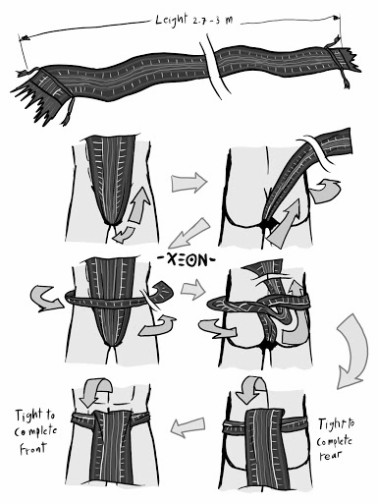
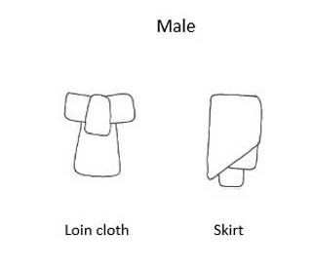
Who wore what?-Men
Breechcloth
Barefoot
Sandals
Hairstyle
Shoe wraps made of animal skin

Slide 6
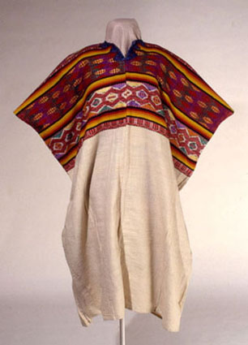
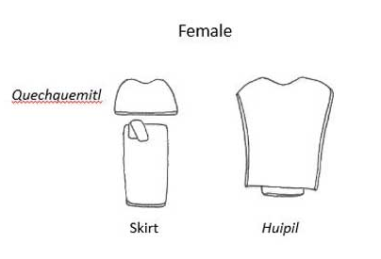
Who wore what?- Women
Hair was typically put up for both sexes.
Cloth could not be woven broadly so it was sewn together

Slide 7
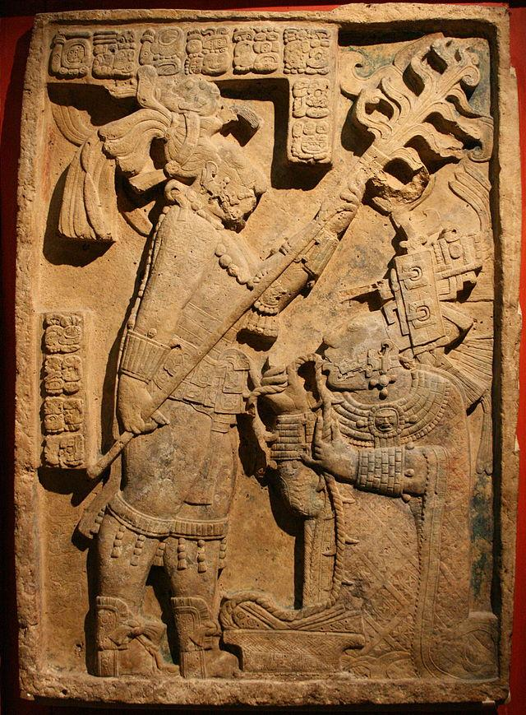
Who wore what?-Nobles
Large Headdresses
Painted bodies/Tattoos
Nose Piercings
Heavy embroidery
Exclusive use of feathers

Slide 8
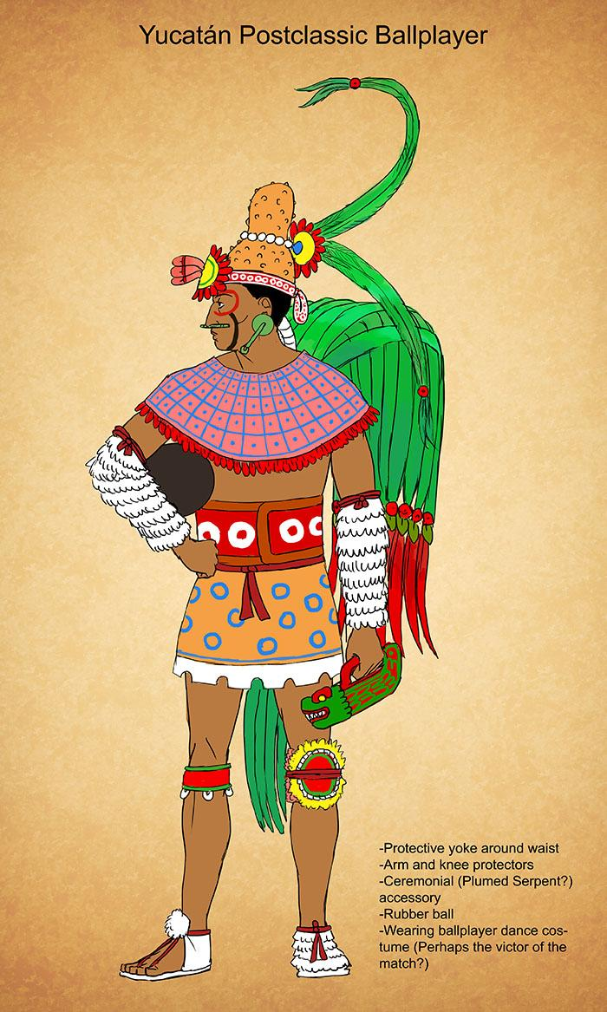
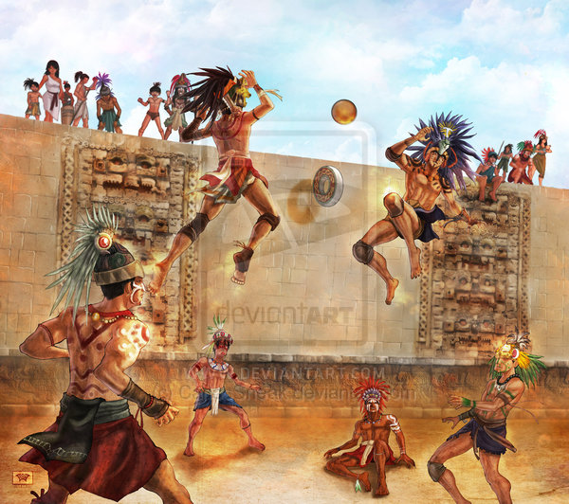
Clothing-Sporting Wear
Ballcourt Games
Feathered headdresses
Animal skins
The finest jewelries
Protective equipments
Yuguito
Yoke
Hacha
Manopla
Notes:
http://kamazotz.deviantart.com/art/Yucatan-Postclassic-Ballplayer-325310105
Yuguito, for knee Yoke, for waist Hacha, on Yoke Manopla, to protect from attack items

Slide 9
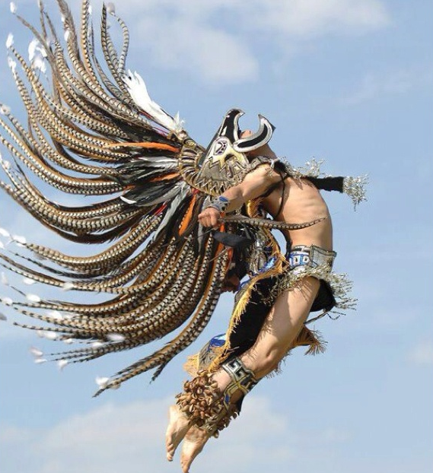
Ceremonial Wear
Decorations
Feathers
Animal Skins
Jewelry
Earrings
Uniforms
Gods
Mythical creatures
Warriors
padded mantle
Shield decoration
Nobles & Priest
Attire was made of quality cloth
Heavily decorated to denote status

Slide 10
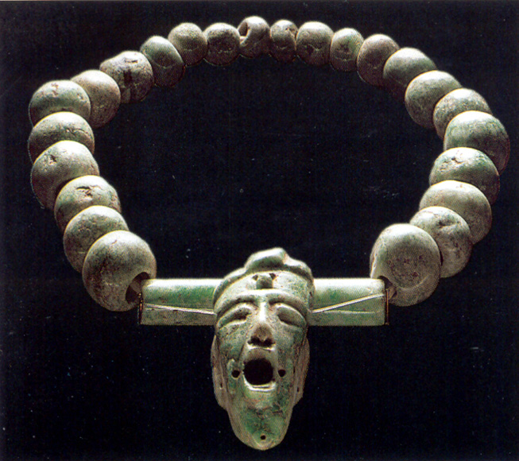
Accessories
Stone
Jade
Often carved/religious
Obsidian
Also for rituals
Shell
Jewelry
Containers
Metal
Animal
Teeth, Claws, Bones
Feathers for headdresses

Slide 11
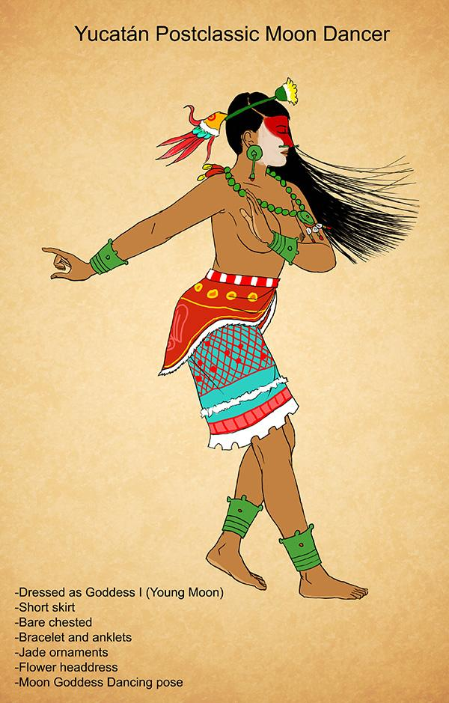
Jewelry
Beaded necklaces
Pendants
Bracelets
Earrings
Ear, Lip and Nose plugs
Nose plugs for noble men
Rings
Elaborate headdresses
Precious stones for filed down teeth
Jewelry with Jade often became gifts or offerings
Notes:
http://kamazotz.deviantart.com/art/Postclassic-Moon-Goddess-Dancer-328458308

Slide 12
References
Aztec Warrior. (n.d.). Retrieved April 12, 2016, from http://avasariah.deviantart.com/art/Aztec-Warrior-357989902
Resources: Ancient Maya Clothing http://www.mexicolore.co.uk/maya/teachers/what-did-the-ancient-maya-wear
Clothing of the Ancient Maya http://ancientmayalife.blogspot.com/2012/12/clothing-of-ancient-maya.html
Clothing of Mayans, Aztecs, and Incas http://www.fashionencyclopedia.com/fashion_costume_culture/Early-Cultures-Mayans-Aztecs-and-Incas/Clothing-of-Mayans-Aztecs-and-Incas.html
Body Decorations of Mayans, Aztecs, and Incas http://www.fashionencyclopedia.com/fashion_costume_culture/Early-Cultures-Mayans-Aztecs-and-Incas/Body-Decorations-of-Mayans-Aztecs-and-Incas.html
The Mesoamerican Ballgame http://www.mesoballgame.org/ballgame/main.php
Notes:
Resources: Ancient Maya Clothing http://www.mexicolore.co.uk/maya/teachers/what-did-the-ancient-maya-wear
Clothing of the Ancient Maya http://ancientmayalife.blogspot.com/2012/12/clothing-of-ancient-maya.html
Clothing of Mayans, Aztecs, and Incas
http://www.fashionencyclopedia.com/fashion_costume_culture/Early-Cultures-Mayans-Aztecs-and-Incas/Clothing-of-Mayans-Aztecs-and-Incas.html
Body Decorations of Mayans, Aztecs, and Incas
http://www.fashionencyclopedia.com/fashion_costume_culture/Early-Cultures-Mayans-Aztecs-and-Incas/Body-Decorations-of-Mayans-Aztecs-and-Incas.html
https://www.flmnh.ufl.edu/maya/maya2.htm
Aztec Warrior. (n.d.). Retrieved April 12, 2016, from http://avasariah.deviantart.com/art/Aztec-Warrior-357989902
The Mesoamerican Ballgame
http://www.mesoballgame.org/ballgame/main.php

