Slide 1
dathompson@csumb.edu

Slide 2
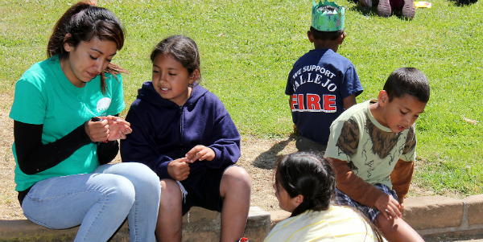
CPY
Mission Statement
Community Partnership for Youth (CPY) is a prevention program providing positive alternatives to gangs, drugs and violence while reinforcing individual strengths. Our vision is to provide our youth with a safe, structured environment that encourages healthy boundaries, positive self-esteem and the ability to make good choices for a full and successful life.

Slide 3
Established in 1991
Community Partnership for Youth was created in spring of 1991 in honor of a student athlete by the name of Ramon Avila who was shot and killed during an alleged drug deal. This program allowed people in the community to collaborate together to come up with creative ways to prevent violence in their area.

Slide 4
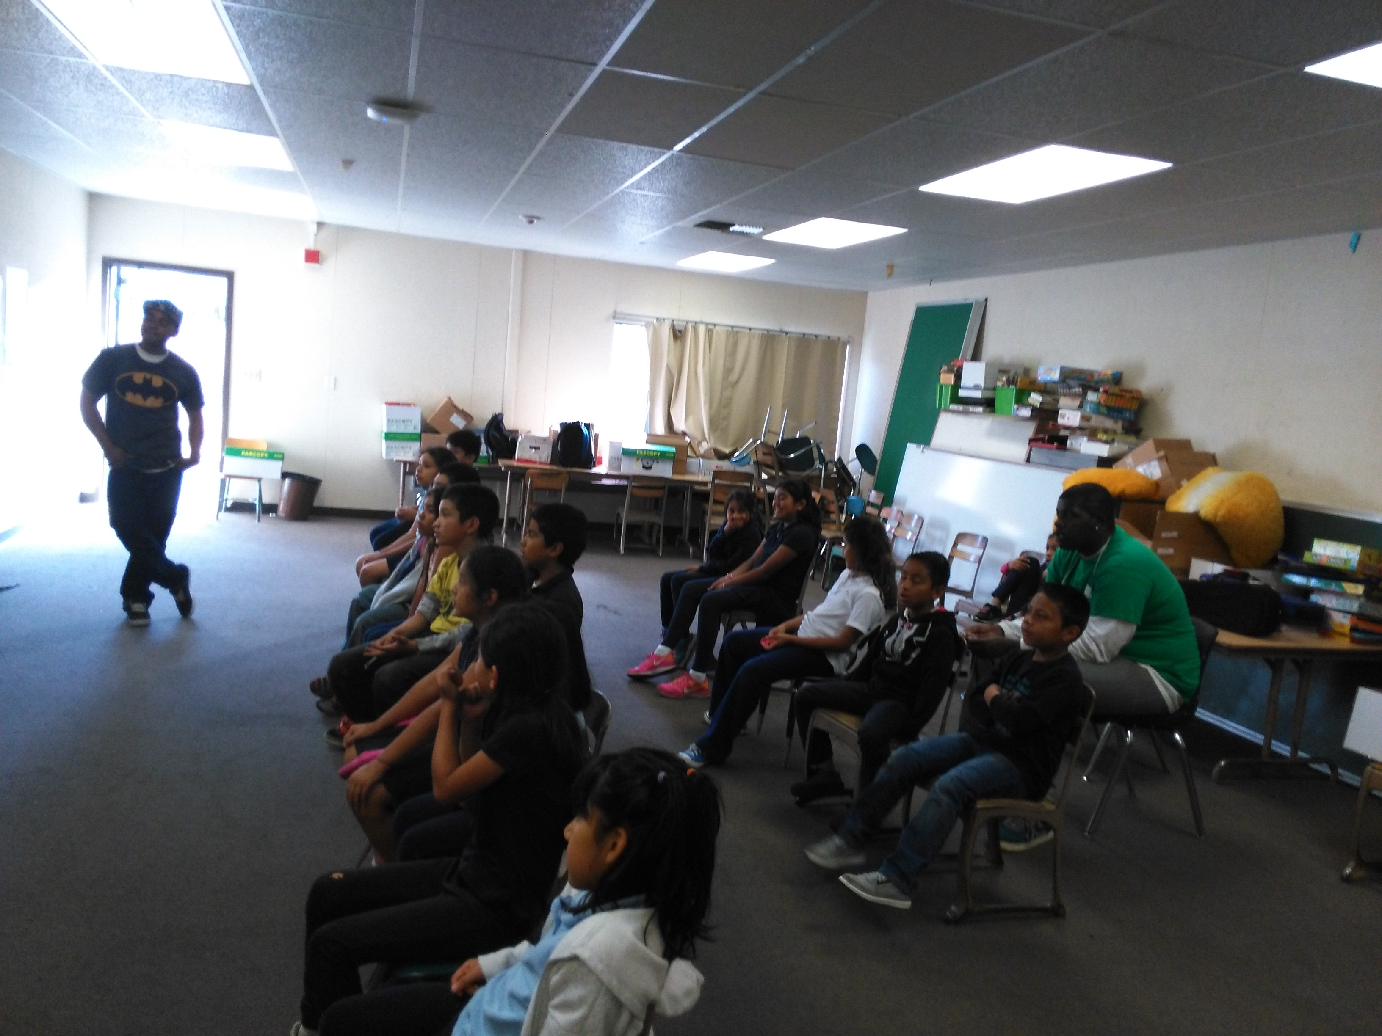
Programs
Students receive help with their homework, reading and interact in “Circle Time”.
In Circle Time, students sing songs and are able to talk about anything that is going on in their daily life.
After School Mentoring/Tutor
Middle School Leadership
High School Leadership
Strengthening Families
Summer Intersession

Slide 5
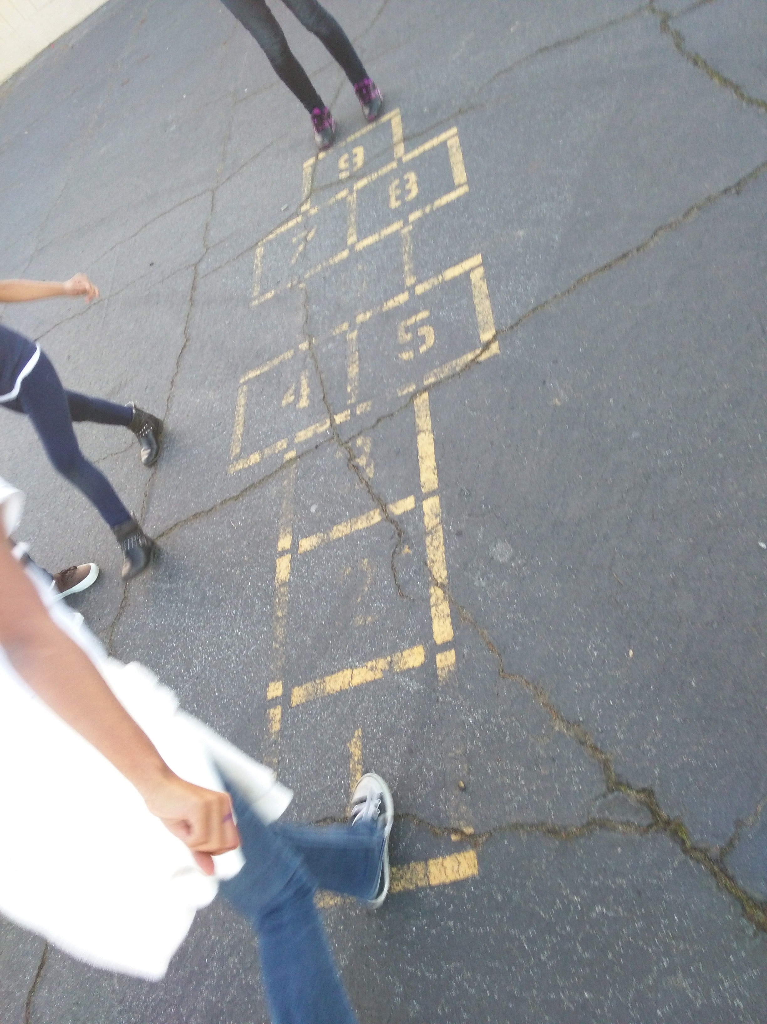
facebook.com/cpy4kids
CPY Video

